Slide 1
Statistics
Basic Probability and Terms

Slide 2
Terms in Probability
Probability
Uncertainity
Likehood
Experiment
Outcome
Sample-Population
Sample space
Sample Points

Slide 3
Counting Rules
Combinations
Permutations
Multi step experiments
Assigning probablities
Classical / Relative/ subjective

Slide 4
Events
Probability of Event
Complement
Addition Law , Multiplication Law
Mutually Exclusive, Conditional Probability, Joint prob, Independent Events
Bayes theorem – Prior, Posterior Probability.

Slide 5
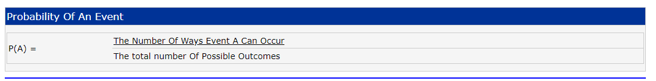
Probability
Probability and statistical information are used for both operational and marketing decisions.
Def :“the extent to which an event is likely to occur, measured by the ratio of the favourable cases to the whole number of cases possible”.

Slide 6
uncertainties
Managers often base their decisions on an analysis of uncertainties such as the following:
1. What are the chances that sales will decrease if we increase prices?
2. What is the likelihood a new assembly method will increase productivity?
3. How likely is it that the project will be finished on time?
4. What is the chance that a new investment will be profitable?

Slide 7
Likehood
Probability originated in a series of letters between Pierre de Fermat and Blaise Pascal in the 1650s.
Probability is a numerical measure of the likelihood that an event will occur.
Thus, probabilities can be used as measures of the degree of uncertainty associated with the four events previously listed.
If probabilities are available, we can determine the likelihood of each event occurring

Slide 8
Range and meaning
Probability values are always assigned on a scale from 0 to 1.
A probability near zero indicates an event is unlikely to occur;
a probability near 1 indicates an event is almost certain to occur.
Other probabilities between 0 and 1 represent degrees of likelihood that an event will occur.
Eg: Probability of Rain by Report, 0.9,0.5,0.2etc.

Slide 9
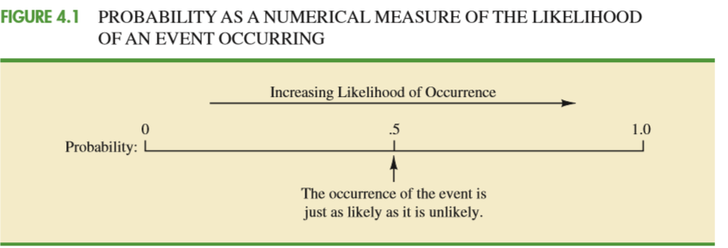

Slide 10
Experiment
we define an experiment as a process that generates well-defined outcomes.
On any single repetition of an experiment,
one and only one of the possible experimental outcomes will occur.

Slide 11
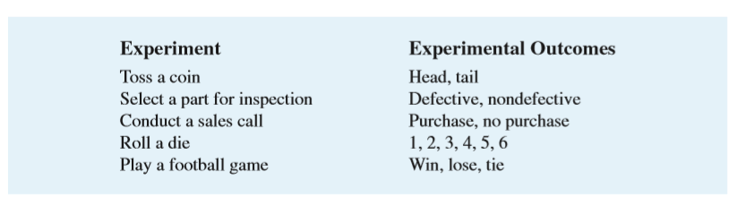
Experiment - Outcome

Slide 12
sample space
By specifying all possible experimental outcomes, we identify the sample space for an experiment.
The sample space for an experiment is the set of all experimental outcomes.
Experimental outcomes are also called sample points
Space and Points

Slide 13
tossing a coin. Sample space with Head and Tail
S = {Head, Tail}
Rolling die
S = {1, 2, 3, 4, 5, 6}

Slide 14
Counting rules
Combinations
Permutations

Slide 15
counting rules
Multiple-step experiments

Slide 16
Multiple-step experiments
Experiment of tossing two coins.
S = {(H, H ), (H, T ), (T, H ), (T, T )}
Thus, we see that four experimental outcomes are possible.
The counting rule for multiple-step experiments makes it possible to determine the number of experimental outcomes without listing them.

Slide 17
COUNTING RULE FOR MULTIPLE-STEP EXPERIMENTS
If an experiment can be described as a
sequence of k steps with n1 possible outcomes on the first step,
n2 possible outcomes on the second step,
and so on, then the total number of experimental outcomes is given by (n1) (n2)...(nk).

Slide 18
Eg:
Viewing the experiment of tossing two coins as a sequence of
first tossing one coin (n1 = 2) and then tossing the other coin (n2 = 2), we can see from the counting rule that (2)(2) 4 distinct experimental outcomes are possible.
As shown, they are S = {(H, H), (H, T), (T, H), (T, T)}. The number of experimental outcomes in an experiment involving tossing six coins is (2)(2)(2)(2)(2)(2) = 64. = 2^6

Slide 19
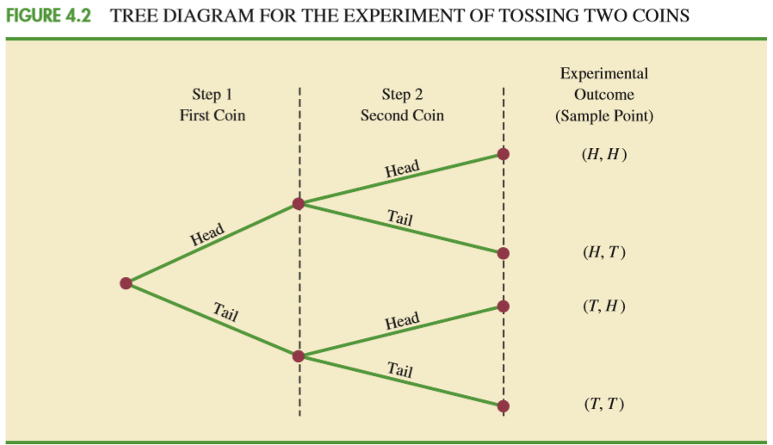

Slide 20
Let us now see how the counting rule for multiple-step experiments can be used in the analysis of a capacity expansion project for the Kentucky Power & Light Company (KP&L).
two sequential stages or steps: stage 1 (design) and stage 2 (construction)
Design = 2,3,4 - # 3 outcomes
Construction = 6,7,8 - # 3 outcomes
– Possible output in 10 months, with Power constraint.
total of (3)(3) 9 experimental outcomes.
(3)(3) = 9 ways of outcome

Slide 21
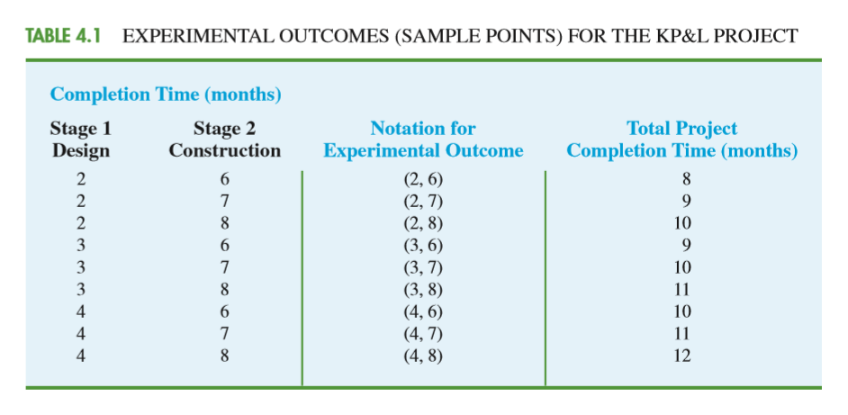
(2, 6) = Design, Construction = 8 Months

Slide 22
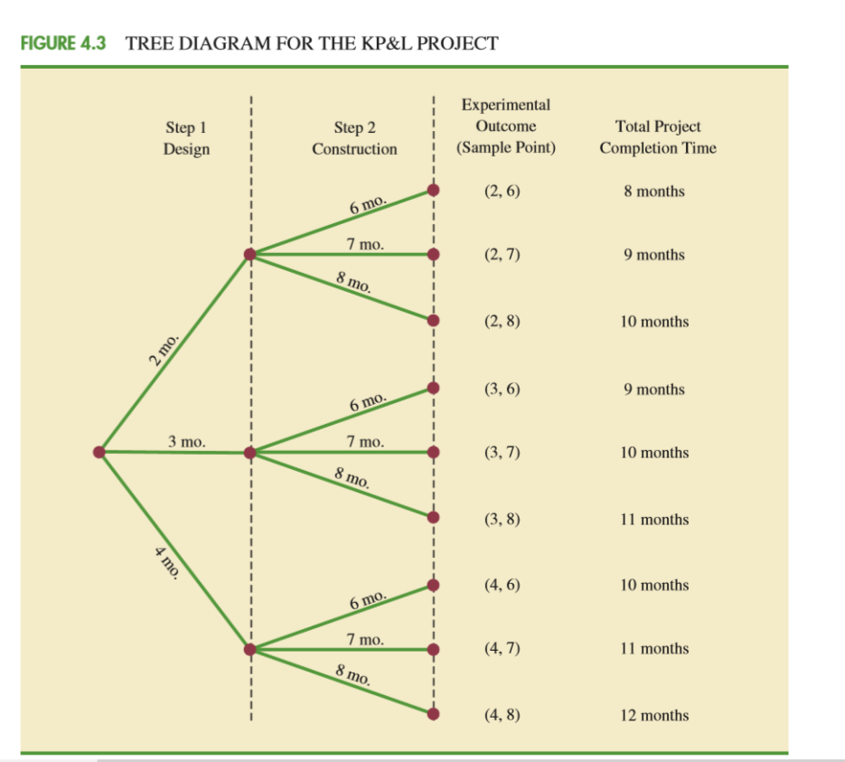

Slide 23
we see that the project will be completed in 8 to 12 months, with six of the nine experimental outcomes providing the desired completion time of 10 months or less

Slide 24
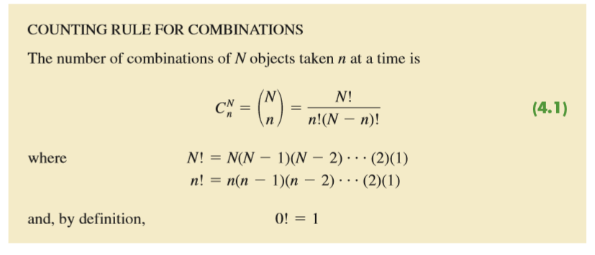
Combinations
experiment involves selecting n objects from a (usually larger) set of N objects. It is called the counting rule for combinations.

Slide 25

The notation ! means factorial; for example, 5 factorial is 5! = (5)(4)(3)(2)(1) = 120.
Inspector randomly selects two of five parts to test for defects – 2 out of 5
In a group of five parts, how many combinations of two parts can be selected? The counting rule in equation shows that with N = 5 and n=2, we have. 10 outcomes are possible

Slide 26
If we label the five parts as A, B, C, D, and E, the 10 combinations or experimental outcomes can be identified as AB, AC, AD, AE, BC, BD, BE, CD, CE, and DE.

Slide 27
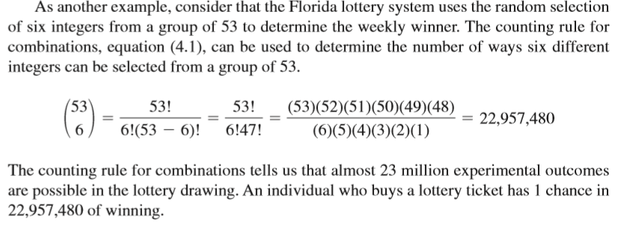
Lottery example 6 Integers – from group of 53

Slide 28
Permutations
A third counting rule
outcomes when n objects are to be selected from a set of N objects where the order of selection Is important .
The same n objects selected in a different order are considered a different experimental outcome.
AB and BA are different – Order is different

Slide 29
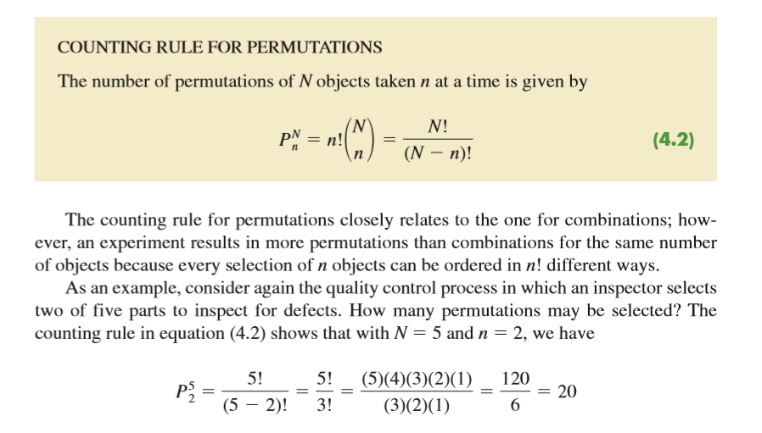
More Permutations than combinations

Slide 30
If we label the parts A, B, C, D, and E,
the 20 permutations are AB, BA, AC, CA, AD, DA, AE, EA, BC, CB, BD, DB, BE, EB, CD, DC, CE, EC, DE, and ED.

Slide 31
Assigning Probabilities
How probabilities can be assigned to experimental outcomes?

Slide 32
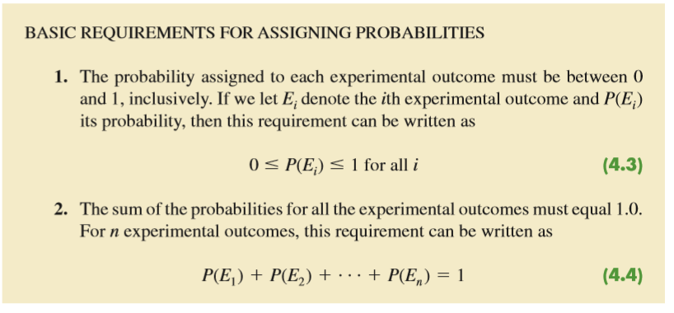
P = 0 to 1 Or Sum = 1

Slide 33
The three approaches most frequently used are the
classical,
Relative frequency
subjective methods

Slide 34
classical method
The classical method of assigning probabilities is appropriate when all the experimental outcomes are equally likely. If n experimental outcomes are possible, a probability of 1/n is assigned to each experimental outcome.
For an example, consider the experiment of tossing a fair coin; the two experimental outcomes—head and tail—are equally likely. Because one of the two equally likely outcomes is a head, the probability of observing a head is 1/2, or .50. Similarly, the probability of observing a tail is also 1/2, or .50.
Rolling dies each number 1/6 chance

Slide 35
Relative Frequency
The relative frequency method of assigning probabilities is appropriate when data are available to estimate the proportion of the time the experimental outcome will occur if the experiment is repeated a large number of times.

Slide 36
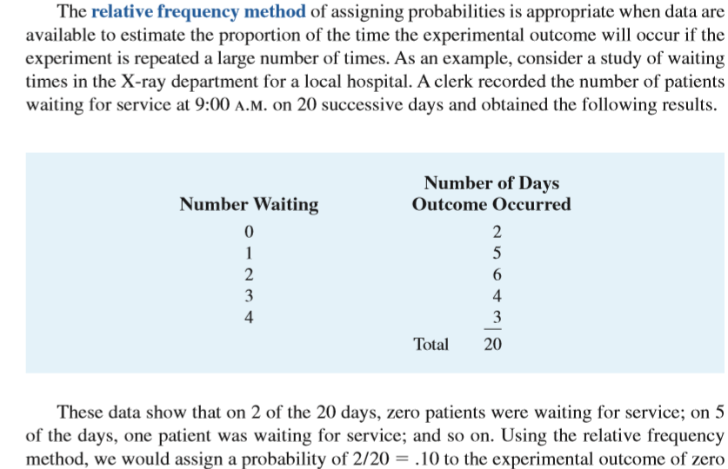
Relative Frequency Eg: Patient waiting time

Slide 37
Subjective method
The subjective method of assigning probabilities is most appropriate when one cannot realistically assume that the experimental outcomes are equally likely and when little relevant data are available.
such as our experience or intuition. After considering all available information, a probability value that expresses our degree of belief (on a scale from 0 to 1) that the experimental outcome will occur is specified.

Slide 38
Consider the case in which Tom and Judy Elsbernd make an offer to purchase a house. Two outcomes are possible:
E1 = their offer is accepted
E2 = their offer is rejected
Judy believes that the probability their offer will be accepted is .8; thus, Judy would set P(E1) = .8 and P(E2) = .2.
Tom, however, believes that the probability that their offer will be accepted is .6; hence, Tom would set P(E1) = .6 and P(E2) = .4.
Note that Tom’s probability estimate for E1 reflects a greater pessimism that their offer will be accepted.

Slide 39
Bayes’theorem provides a means for combining subjectively determined prior probabilities with probabilities obtained by other means to obtain revised, or posterior, probabilities.
Will discuss later ..
Combinations of all 3 methods

Slide 40
KP&Lproject Probabilities
All experimental outcomes were not equally likely. – so No classical method.
Study of the completion times for similar projects undertaken by KP&L over the past three years. - Relative frequency

Slide 41
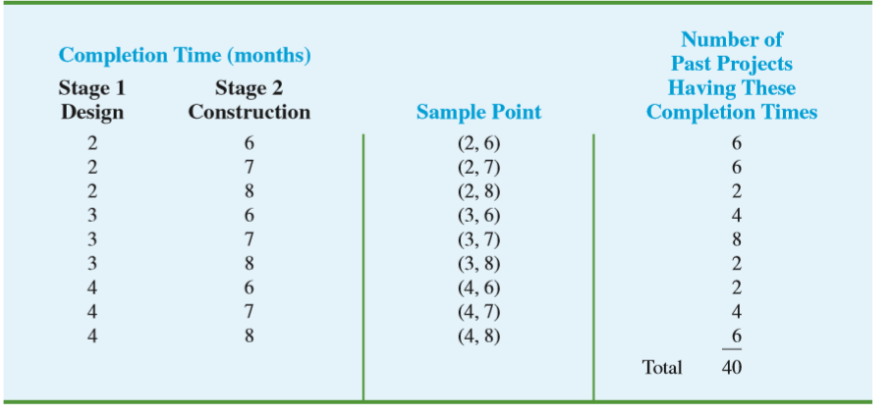

Slide 42
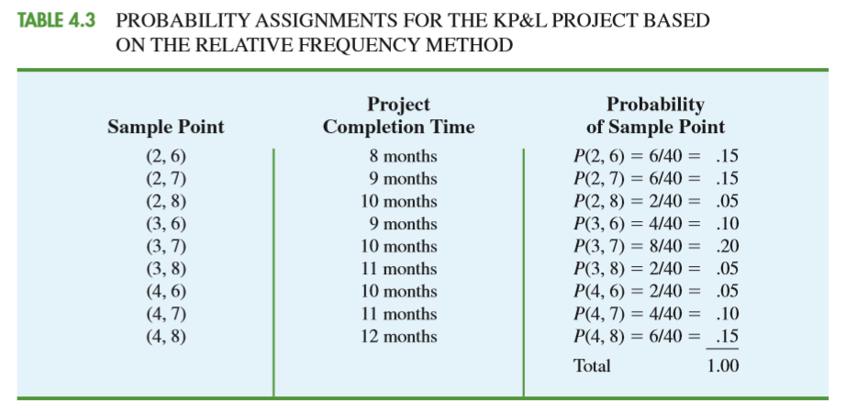

Slide 43
Experiment
In statistics, the notion of an experiment differs somewhat from the notion of an experiment in the physical sciences.
In the physical sciences, researchers usually conduct an experiment in a laboratory or a controlled environment in order to learn about cause and effect.
In statistical experiments, probability determines outcomes.
Even though the experiment is repeated in exactly the same way, an entirely different outcome may occur. Because of this influence of probability on the outcome, the experiments of statistics are sometimes called random experiments

Slide 44
Events and probability
EVENT
An event is a collection of sample points.
Sample points and events provide the foundation for the study of probability.

Slide 45
For an example, let us return to the KP&L project and assume that the project manager is interested in the
event that the entire project can be completed in 10 months or less.
Referring to Table, we see that six sample points—(2, 6), (2, 7), (2, 8), (3, 6), (3, 7), and (4, 6)—provide a project completion time of 10 months or less.
Let C denote the event that the project is completed in 10 months or less;

Slide 46
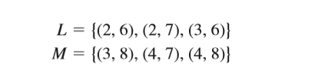
C = {(2, 6), (2, 7), (2, 8), (3, 6), (3, 7), (4, 6)}
L = The event that the project is completed in less than 10 months
M = The event that the project is completed in more than 10 months .

Slide 47
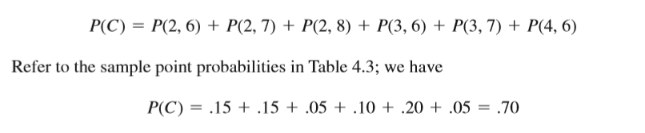
PROBABILITY OF AN EVENT
The probability of any event is equal to the sum of the probabilities of the sample points in the event.

Slide 48
Conclusions
P(L) = 0.4
P(M) = 0.3
Using these probability results, we can now tell KP&L management that
there is a .70 probability that the project will be completed in 10 months or less,
a .40 probability that the project will be completed in less than 10 months,
and a .30 probability that the project will be completed in more than 10 months.
This procedure of computing event probabilities can be repeated for any event of interest to the KP&L management.

Slide 49
Basic Relationship of Probability
complement of an Event
Given an event A, the complement of A is defined to be the event consisting of all sample points that are not in A.

Slide 50

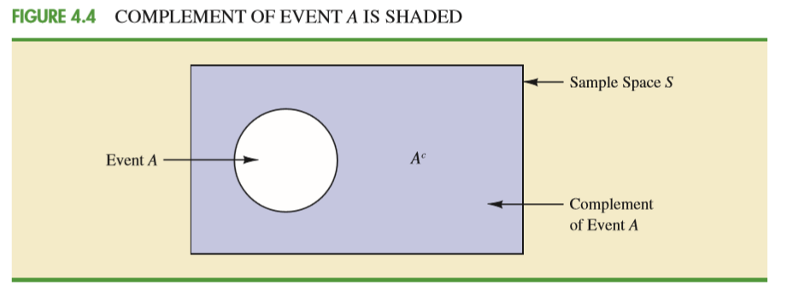
The complement of A is denoted by Ac, in Venn diagram.

Slide 51



Slide 52

Addition law
A+B
the union of events - AUB
the intersection of events – A intersection – B
UNION OF TWO EVENTS The union of A and B is the event containing all sample points belonging to A or B or both. The union is denoted by

Slide 53
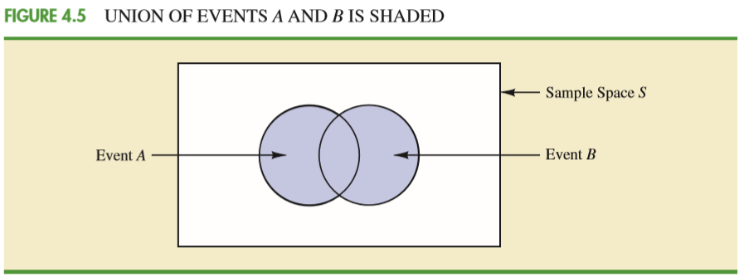

Slide 54

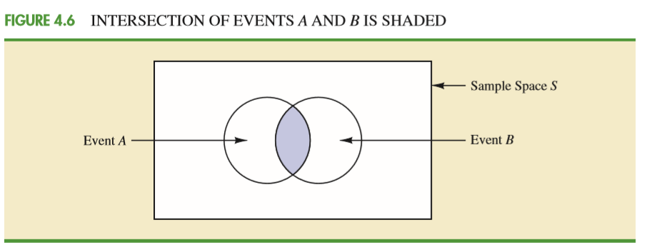
INTERSECTION OF TWO EVENTS Given two events A and B, the intersection of A and B is the event containing the sample points belonging to both A and B. The intersection is denoted by

Slide 55


Slide 56
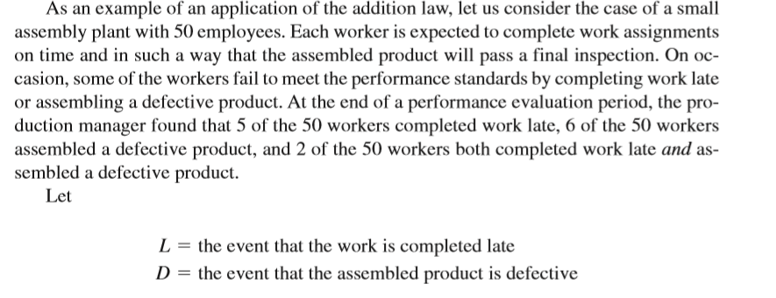
Example of Addition Law

Slide 57
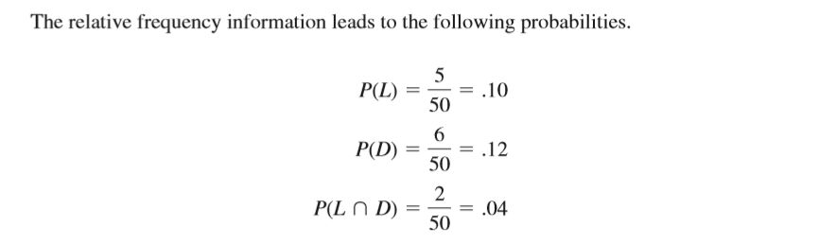

Slide 58
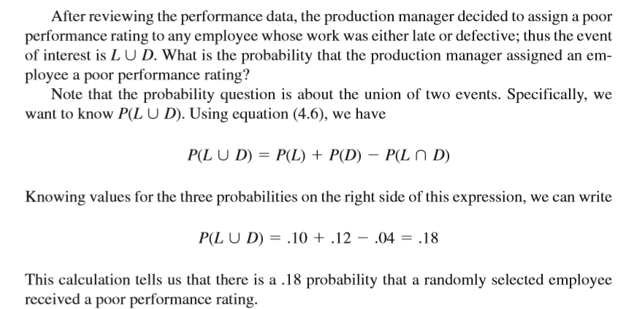
L u D

Slide 59

mutually exclusive events
Two events are said to be mutually exclusive if the events have no sample points in common.
Thus,a requirement for A and B to be mutually exclusive is that their intersection must contain no sample points.

Slide 60
conditional probability
This new probability of event A is called a conditional probability and is written P(A | B). We use the notation to indicate that we are considering the probability of event A given the condition that event B has occurred. Hence, the notation P(A | B) reads “the probability of A given B.”

Slide 61
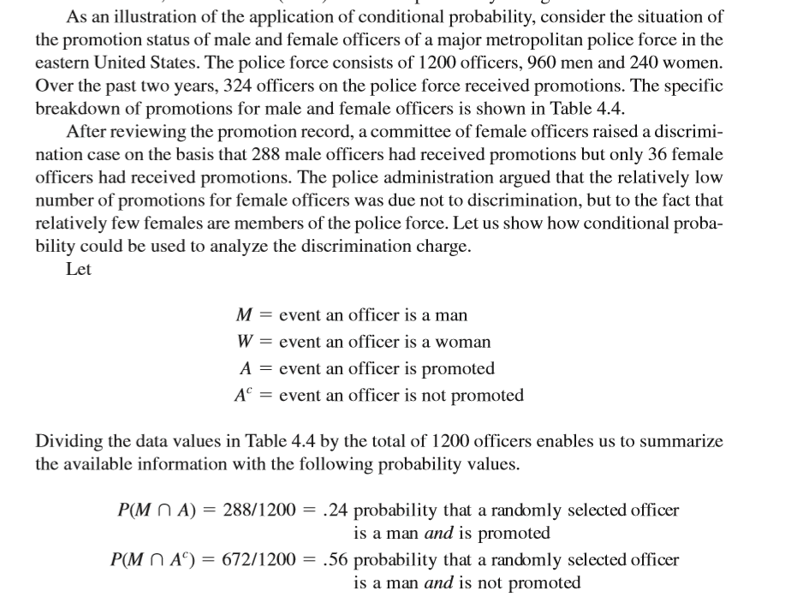

Slide 62
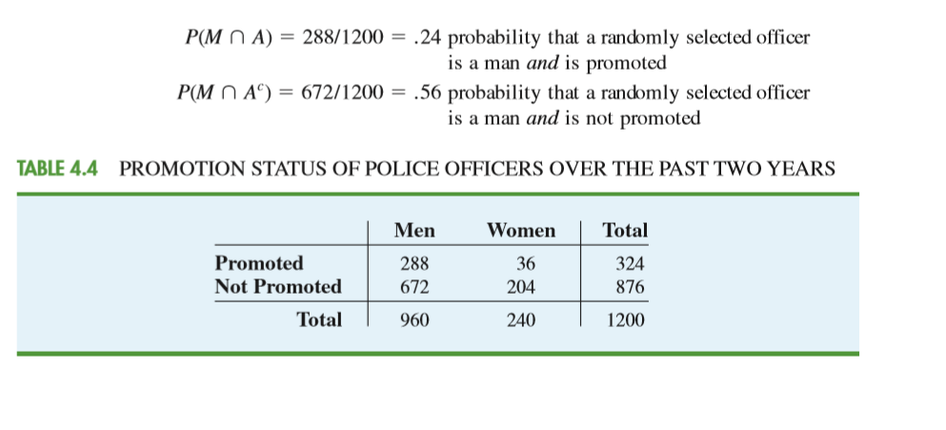

Slide 63
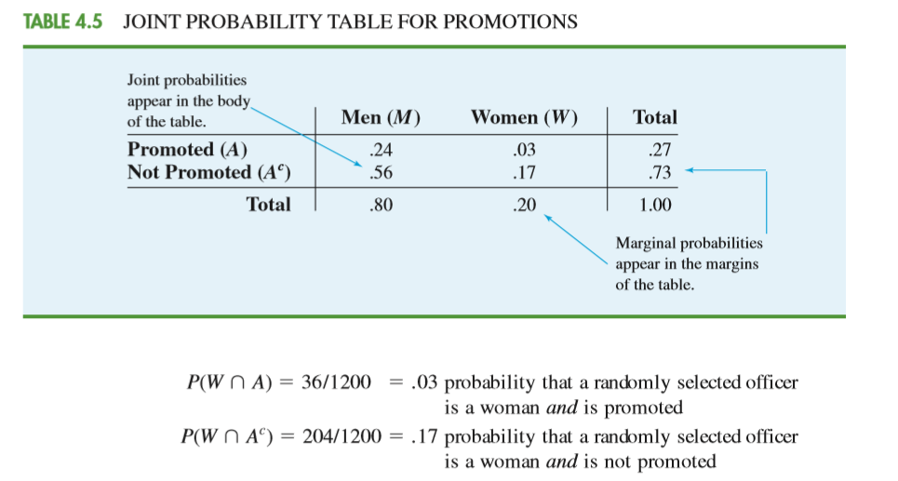

Slide 64
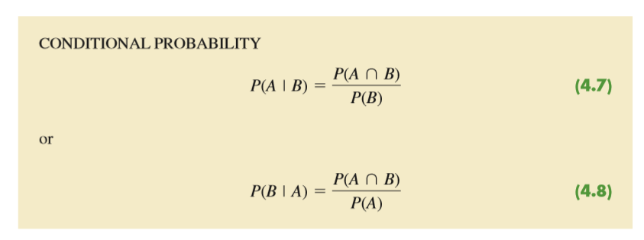

Slide 65
What conclusion do you draw? The probability of a promotion given that the officer is a man is .30, twice the .15 probability of a promotion given that the officer is a woman. Although the use of conditional probability does not in itself prove that discrimination exists in this case, the conditional probability values support the argument presented by the female officers.

Slide 66
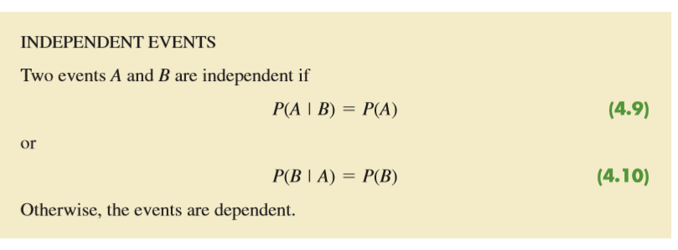
independent events
However, if the probability of event
A is not changed by the existence of event M—that is, P(A | M) , P(A)—we would say that events A and M are independent events.

Slide 67
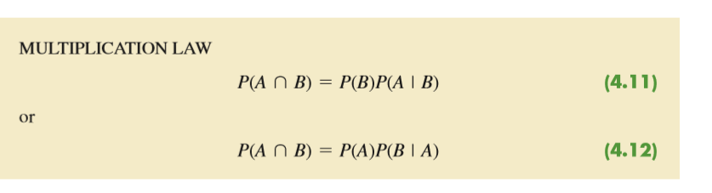
multiplication law

Slide 68
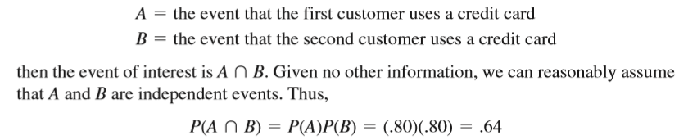


Slide 69
Do not confuse the notion of
mutually exclusive events with that of independent events.
Two events with nonzero probabilities cannot be both mutually exclusive and independent.
If one mutually exclusive event is known to occur, the other cannot occur; thus, the probability of the other event occurring is reduced to zero. They are therefore dependent.

Slide 70
Bayes’ theorem
Often, we begin the analysis with initial or prior probability estimates for specific events of interest.
Then, from sources such as a sample, a special report, or a product test, we obtain additional information about the events.
Given this new information, we update the prior probability values by calculating revised probabilities, referred to as posterior probabilities.

Slide 71
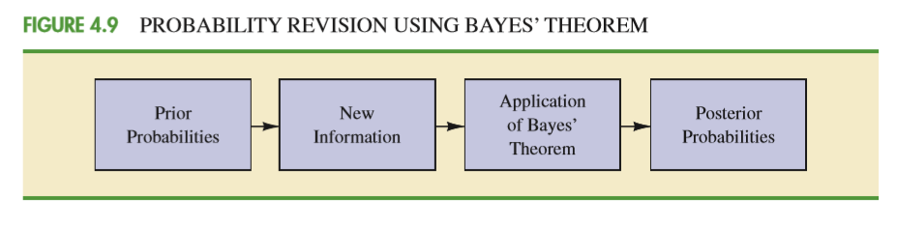

Slide 72
As an application of Bayes’theorem, consider a manufacturing firm that receives shipments of parts from two different suppliers. Let A1 denote the event that a part is from supplier 1 and A2 denote the event that a part is from supplier 2. Currently, 65% of the parts purchased by the company are from supplier 1 and the remaining 35% are from supplier 2. Hence, if a part is selected at random, we would assign the prior probabilities P(A1) = .65 and P(A2) = .35.

Slide 73
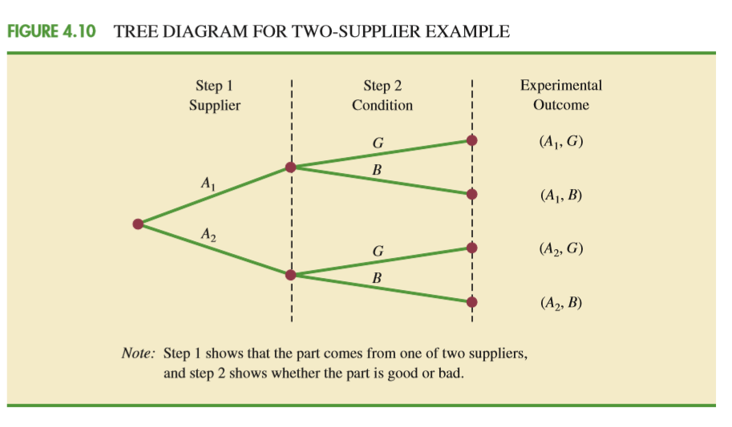

Slide 74
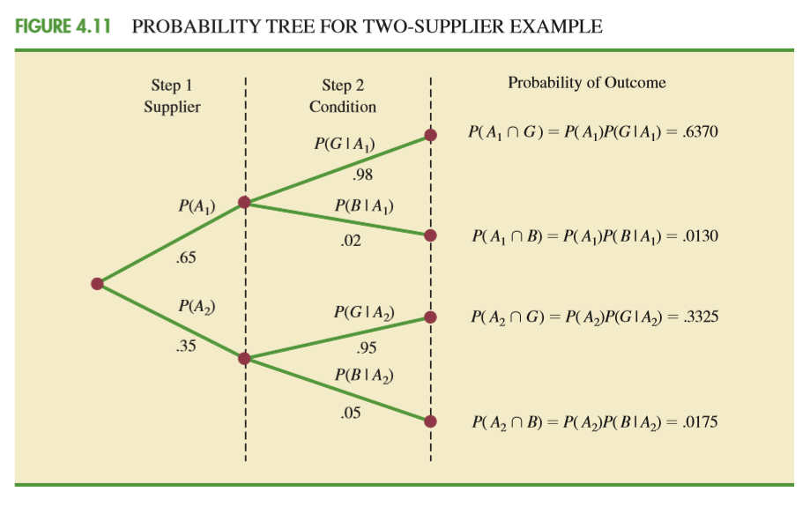

Slide 75
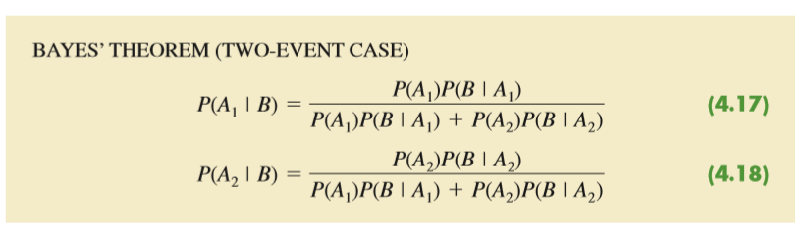

Slide 76
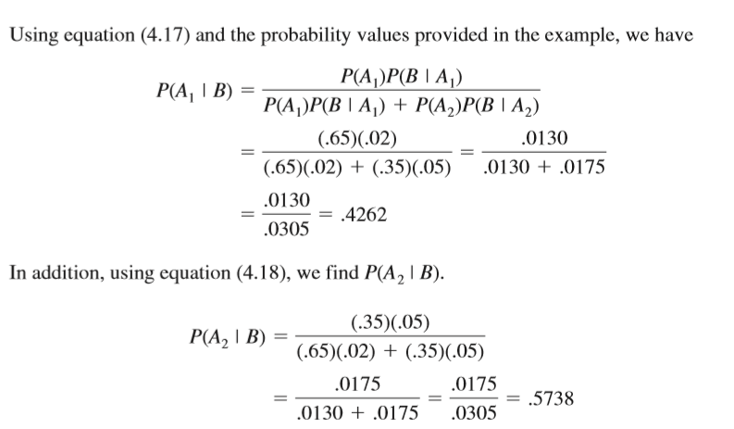

Slide 77
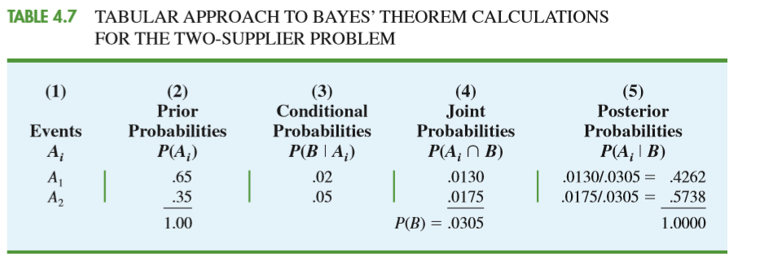

Slide 78
Bayes theorem applicable in Bidding any projects.

